Slide 1
CLAIMS MANAGEMENT SYSTEM

Slide 2







Table of Contents
Problem statement Overview
Features Architecture
Technology Deployment

Slide 3








OUR TEAM
Vasu Raghuram Tirupathi Noor Afreen Shaik
Pandu Ulisi Nabnit Patra
Pavani Nagineni Maneesha Chandhaka

Slide 4


PROBLEM STATEMENT
A leading HealthCare Management Organization wants to strengthen its middleware by exposing the core logic related to Claims Management as Microservices.
The middleware Microservices are to be hosted on Cloud.
Member Portal to be developed that consumes these Microservices and responds back to members who are in need of Claim related information.

Slide 5

OVERVIEW
List of Microservices
MEMBER PORTAL
AUTHORIZATION MICROSERVICE
MEMBER MICROSERVICE
CLAIMS MICROSERVICE
POLICY MICROSERVICE

Slide 6


FEATURES
The user can submit claim details like:
Submit claim: 1) Member ID
2) Hospital name
3) Policy name
4) Benefit name
5) Claim ID
6) Claim Amount
The claim will be submitted successfully if the details are valid.
And the claim status will be shown after successful submission.

Slide 7


FEATURES
The user can view their claim status like:
View claim status: 1) Claim ID
2) Policy name
3) Member ID
The user can check the status of a particular claim with the given claim ID, policy name and their member ID.
For instance, Claim is pending as more documents are needed for verification.

Slide 8


FEATURES
The user can view their bills like:
View bills: 1) Member ID
The user can check their bills of a particular claim with the given member ID.

Slide 9

ARCHITECTURE
Actor
Member portal
Member service
Claim service
Policy service
Authorization

Slide 10
ARCHITECTURE
Authorization Microservice:
Claim service
Policy service
Validating token for authorization of user
GET/Validate
Member service
Authorization
Member portal
Generating JWT token on successful login
POST/Login

Slide 11
ARCHITECTURE
Member Microservice:
Authorization
Submitting Claim
POST/submitDetails
Validating User
POST/token
Get Bills Info
Member Portal
GET/viewBills
Member
Claim
Getting claim Status
GET/claimStatus
Submitting claim
Get Bills
POST/submitDetails
Getting claim status
GET/ClaimStatus
Bills table

Slide 12
ARCHITECTURE
Claims Microservice:
Authorization
Getting list of providers(Hospitals)
GET/getChainOfProviders
Validating User
POST/token
Get Claim Status
Member
GET/claimStatus
Claim
Getting Eligible benefits
GET/getEligibleBenefits
Policy
Submitting claim
POST/submitDetails
Get claim status
Getting Eligible claim amount
GET/getEligibleClaimAmount
Claims table
If the claim data is valid, Claim will be saved in table and status will be returned.

Slide 13
ARCHITECTURE
If policy id and member id is valid then claim amount based on the policy is fetched
Policy Microservice:
Authorization
Policy table
Validating users
POST/token
Getting chain of providers
GET/claimStatus
Claim
Policy
Getting eligible claim amount
Getting eligible benefits
Getting eligible benefits
Join table of policy and benefits
Getting claim amount
GET/getClaimAmount
Getting chain of providers
Provider_Benefits
Join table of policy and hospital
Provider_Policy
If policy id and member id is valid then benefits provided by policy is fetched
If policy id is valid then list of hospitals providing that policy is fetched

Slide 14
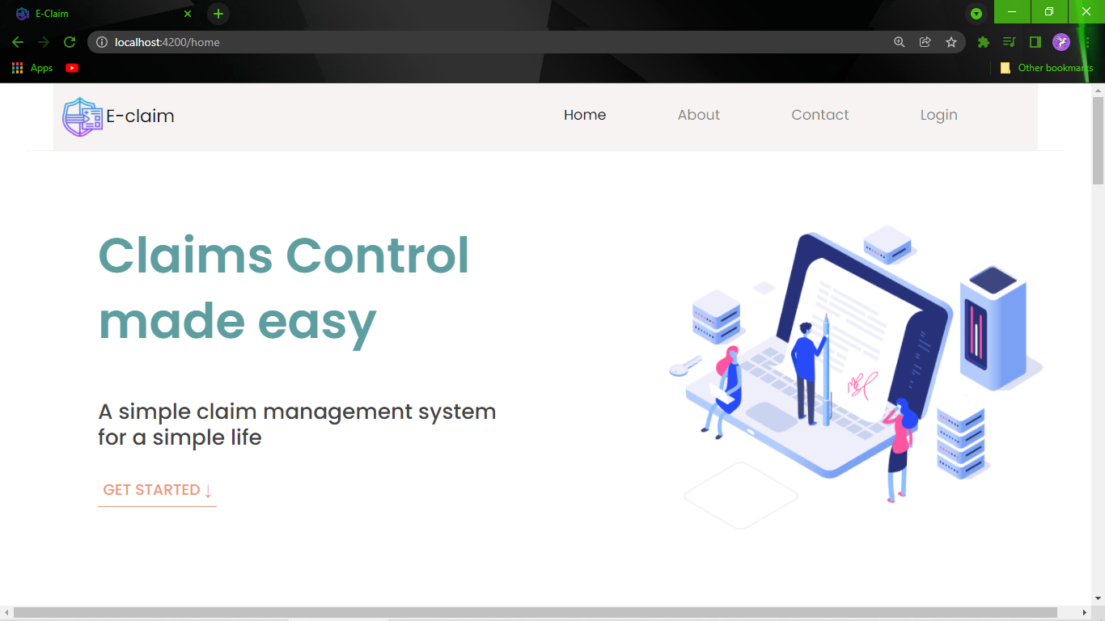
ARCHITECTURE
Member Portal:

Slide 15



TECHNOLOGY
Technology/ Frameworks used:
FrontEnd: Angular
Backend: Spring MVC with Spring Boot
Spring Data JPA
H2 In Memory DB
Testing: jUnit 4/jUnit 5
Mockito

Slide 16


TECHNOLOGY
Technology/ Frameworks used:
DevOps&Cloud: Docker
AWS CI/CD
AWS ECS
AWS S3
Ancillary: Maven,
Lombok

Slide 17
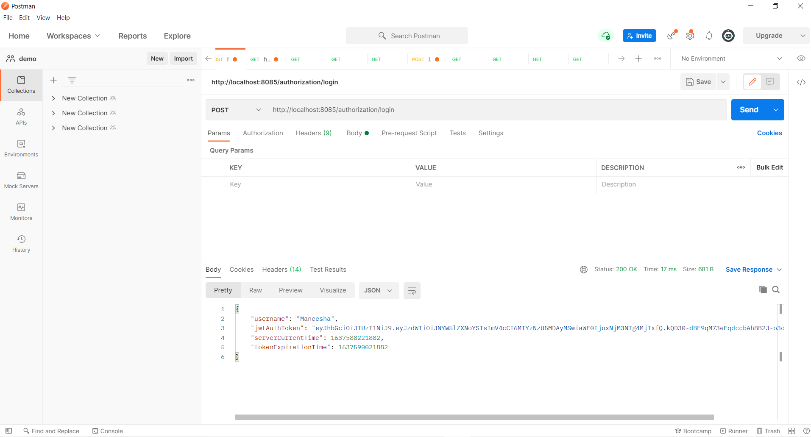
Authorization

Slide 18
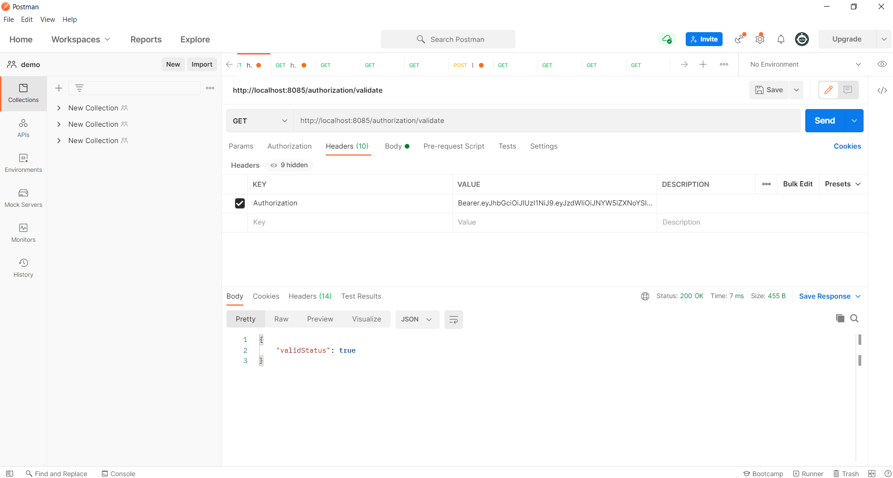
Authorization

Slide 19
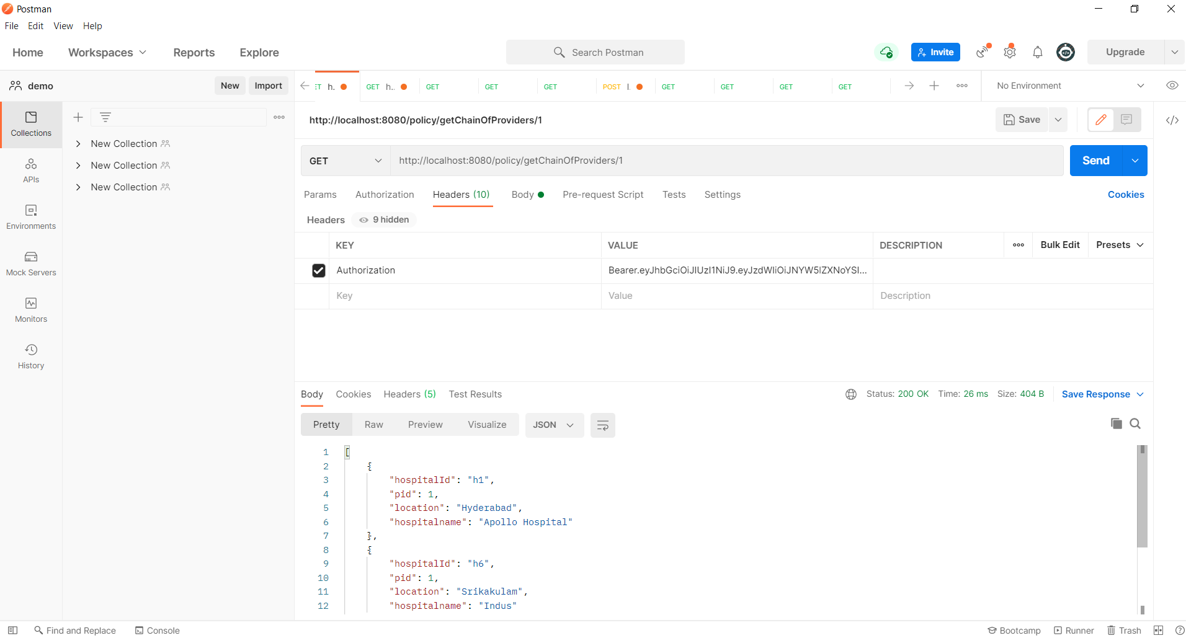
Policy

Slide 20
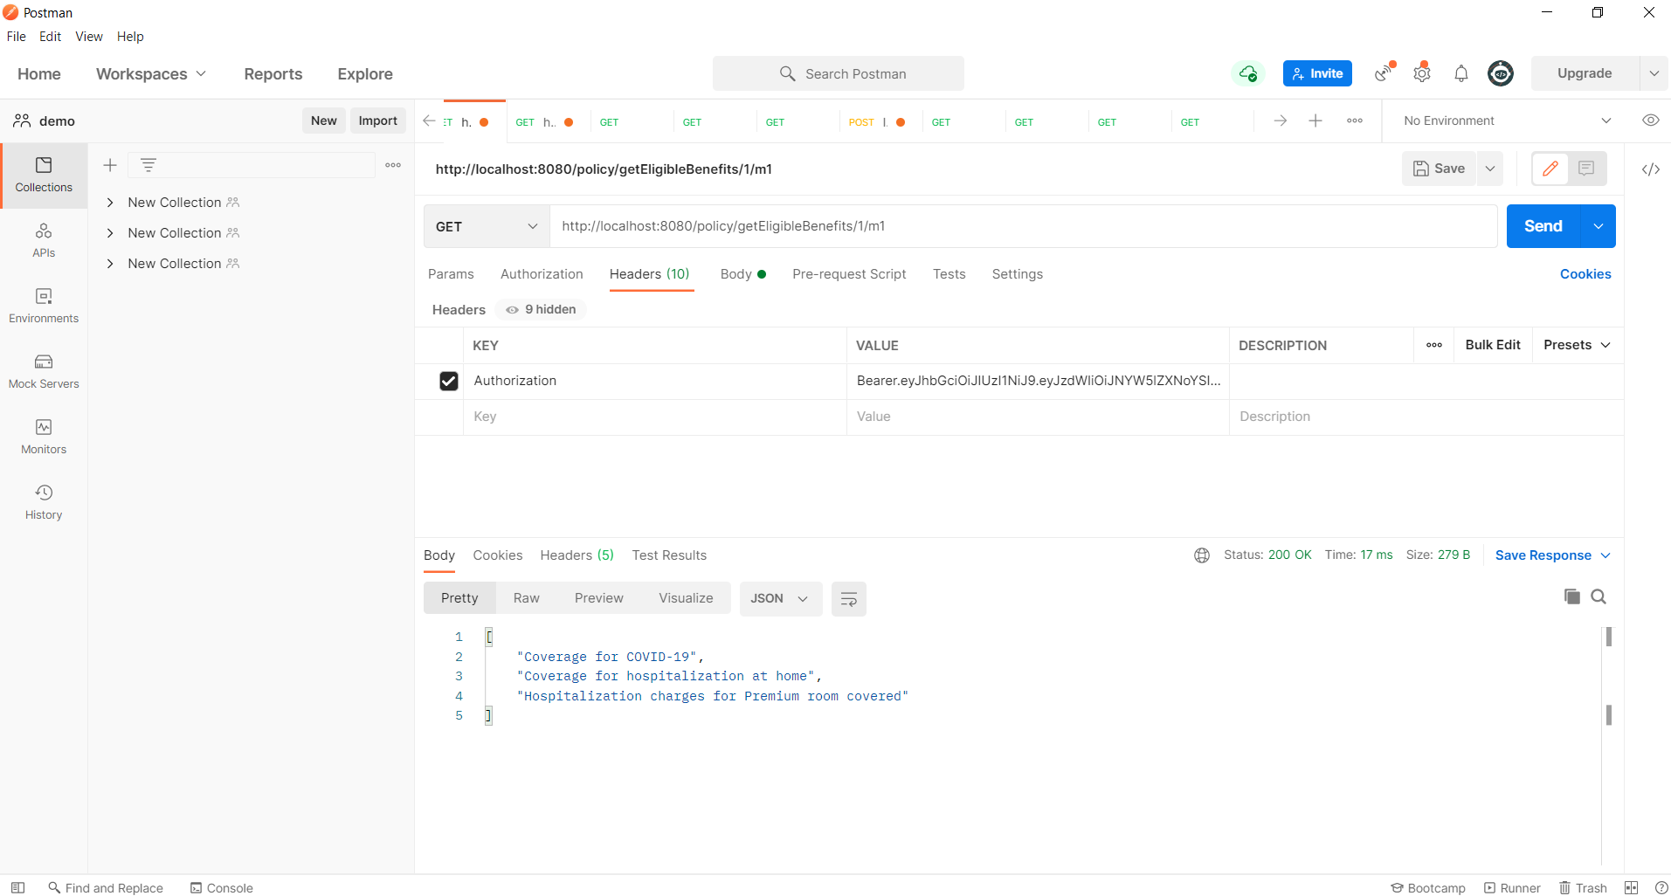
Policy

Slide 21
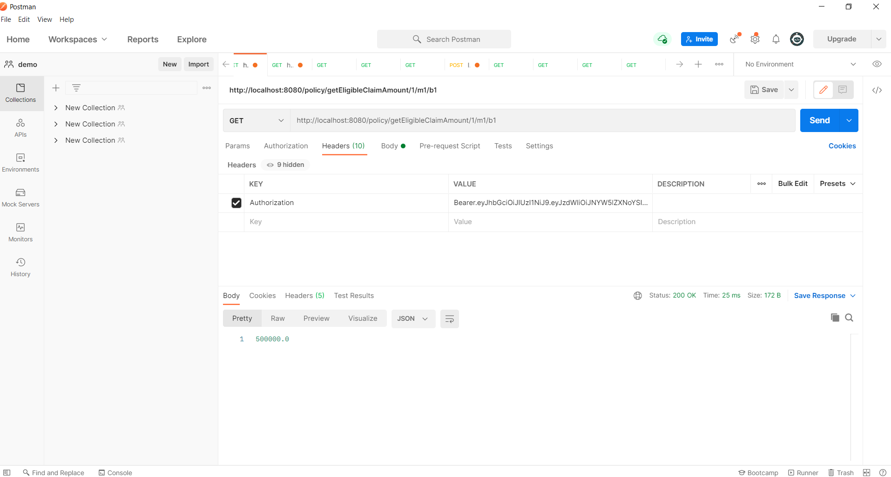
Policy

Slide 22
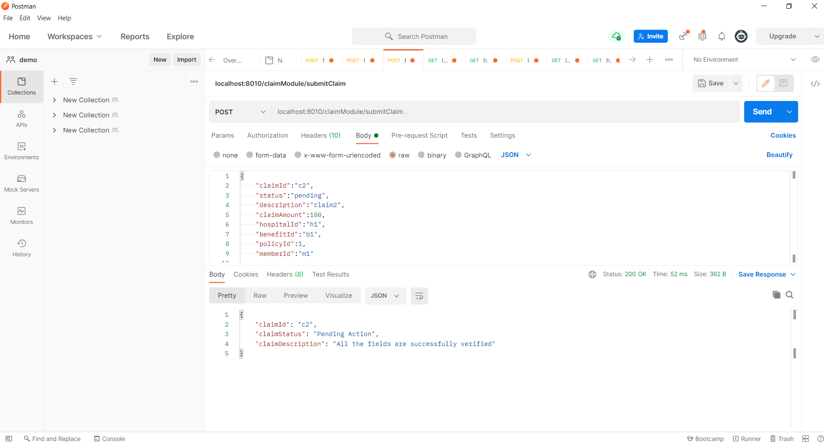
Claim

Slide 23
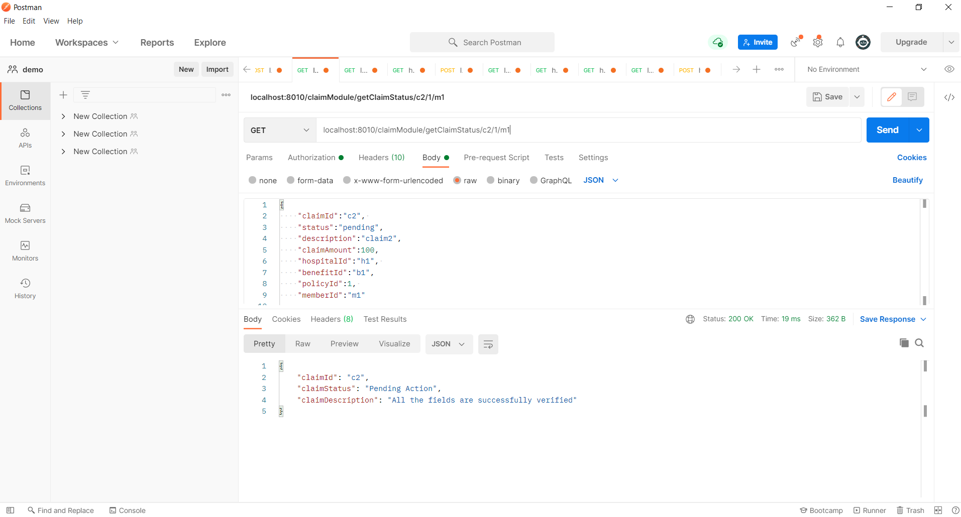
Claim

Slide 24
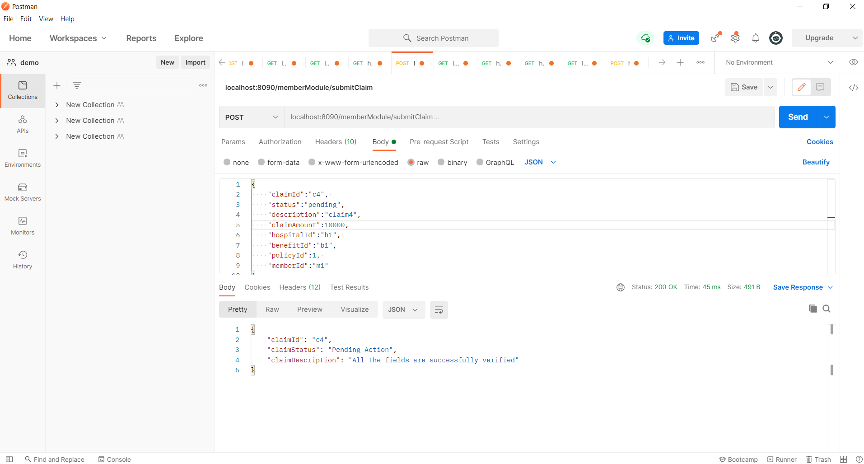
Member

Slide 25
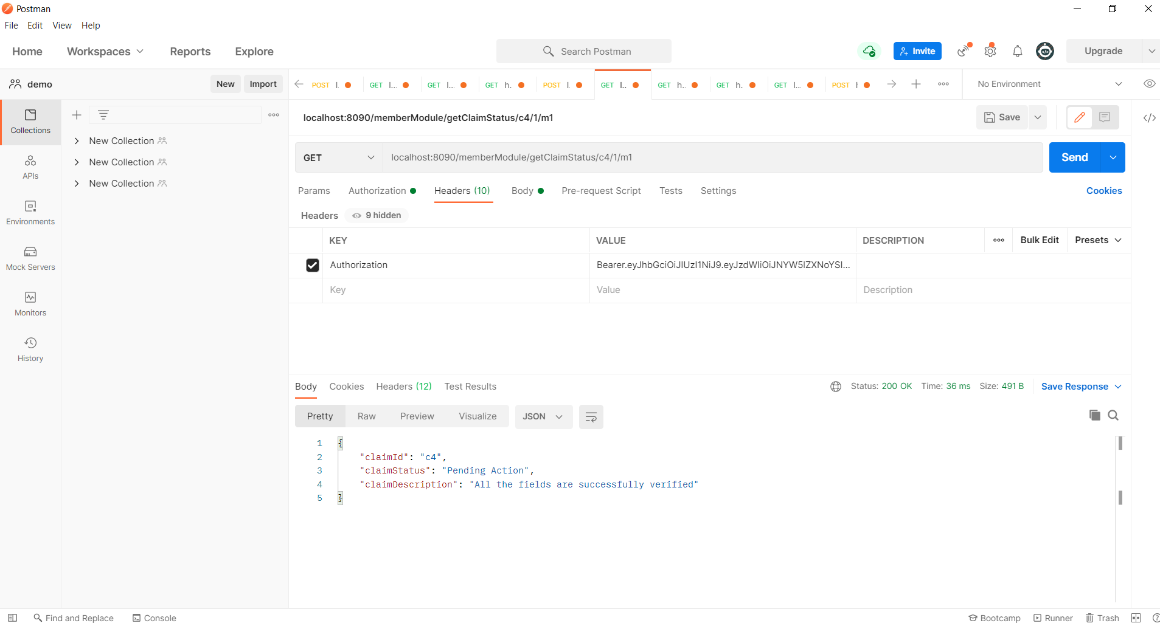
Member

Slide 26
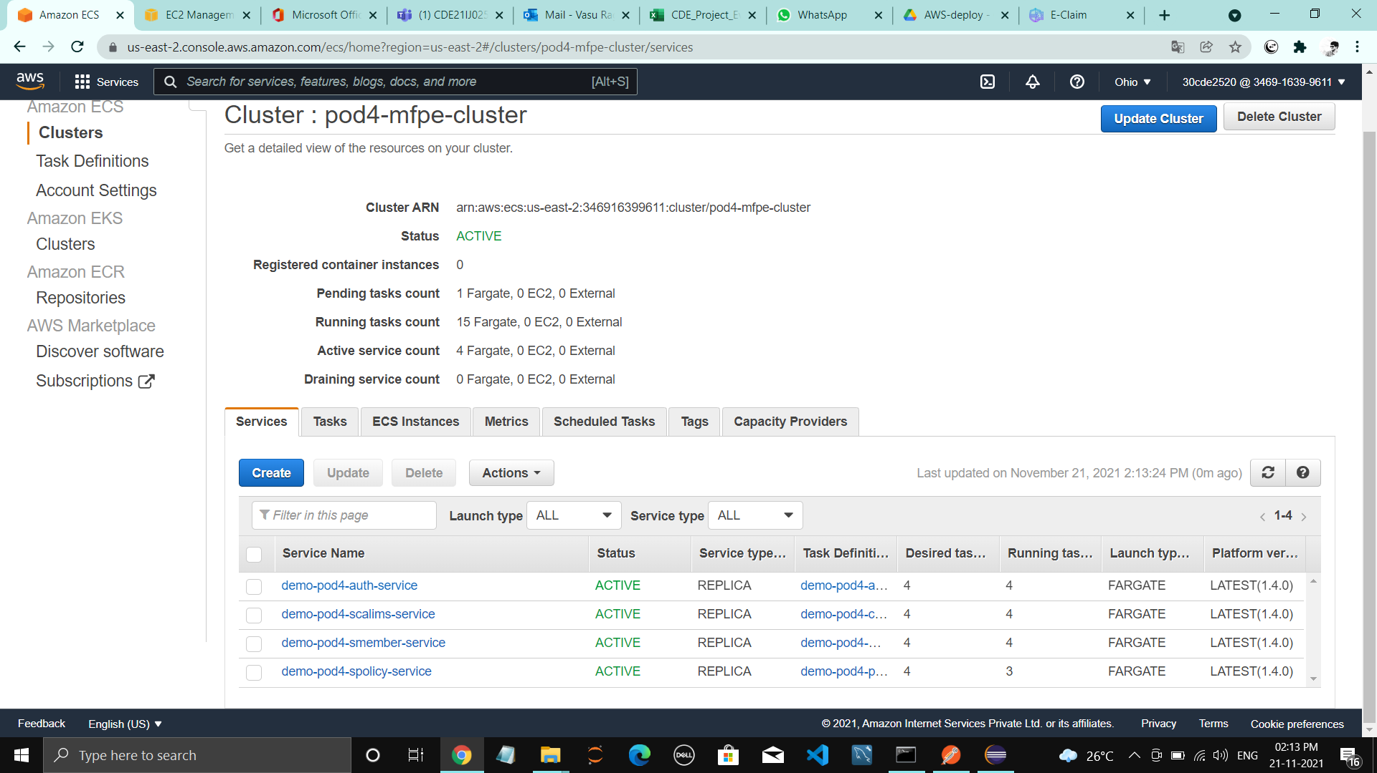
DEPLOYMENT
CLOUD DEPLOYMENT - CLUSTER(SERVICES)

Slide 27
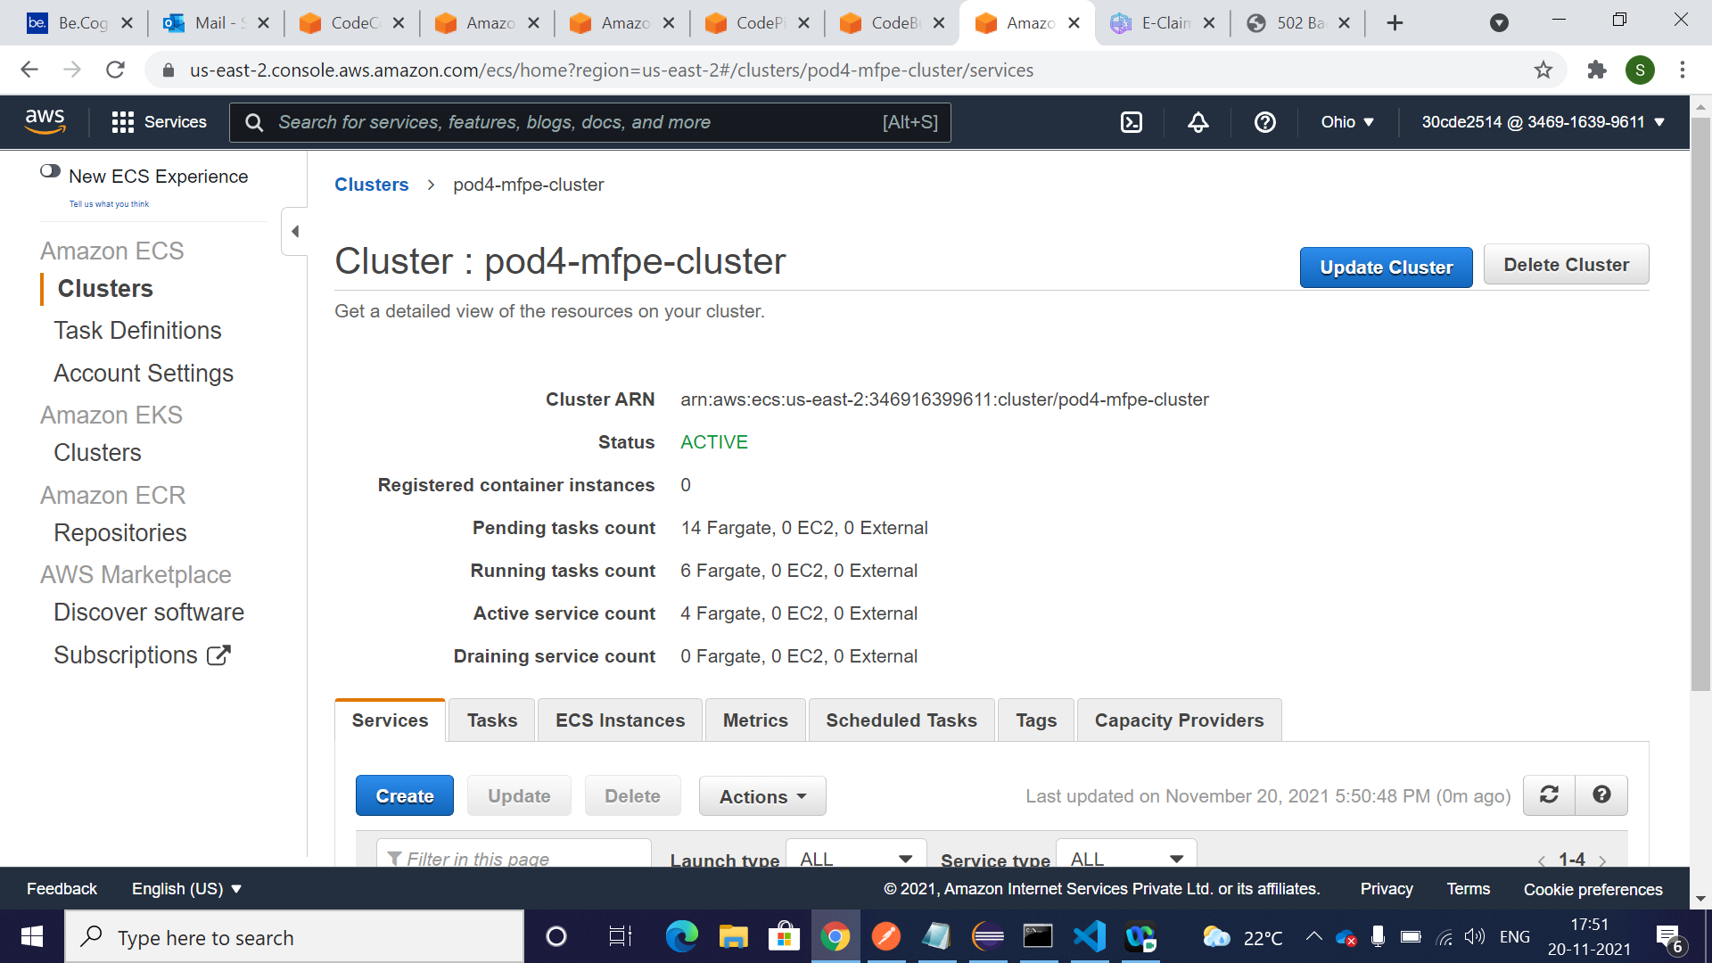
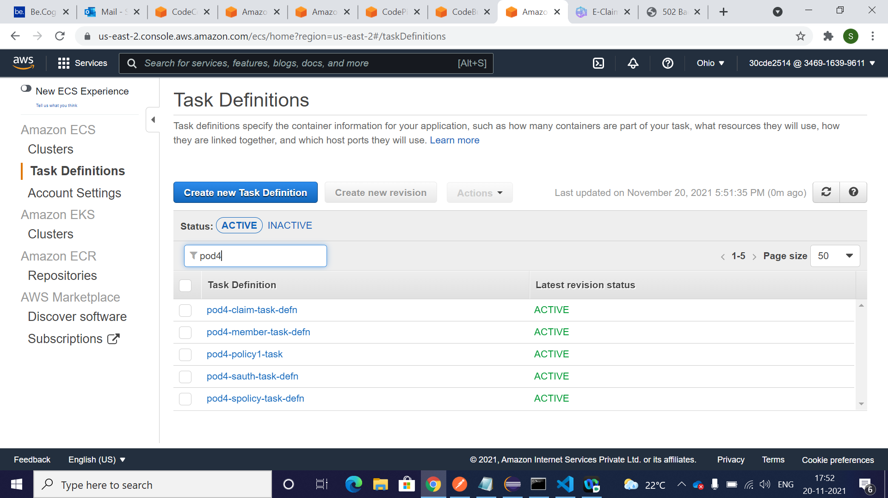
DEPLOYMENT
CLOUD DEPLOYMENT - CLUSTER(TASKS)

Slide 28
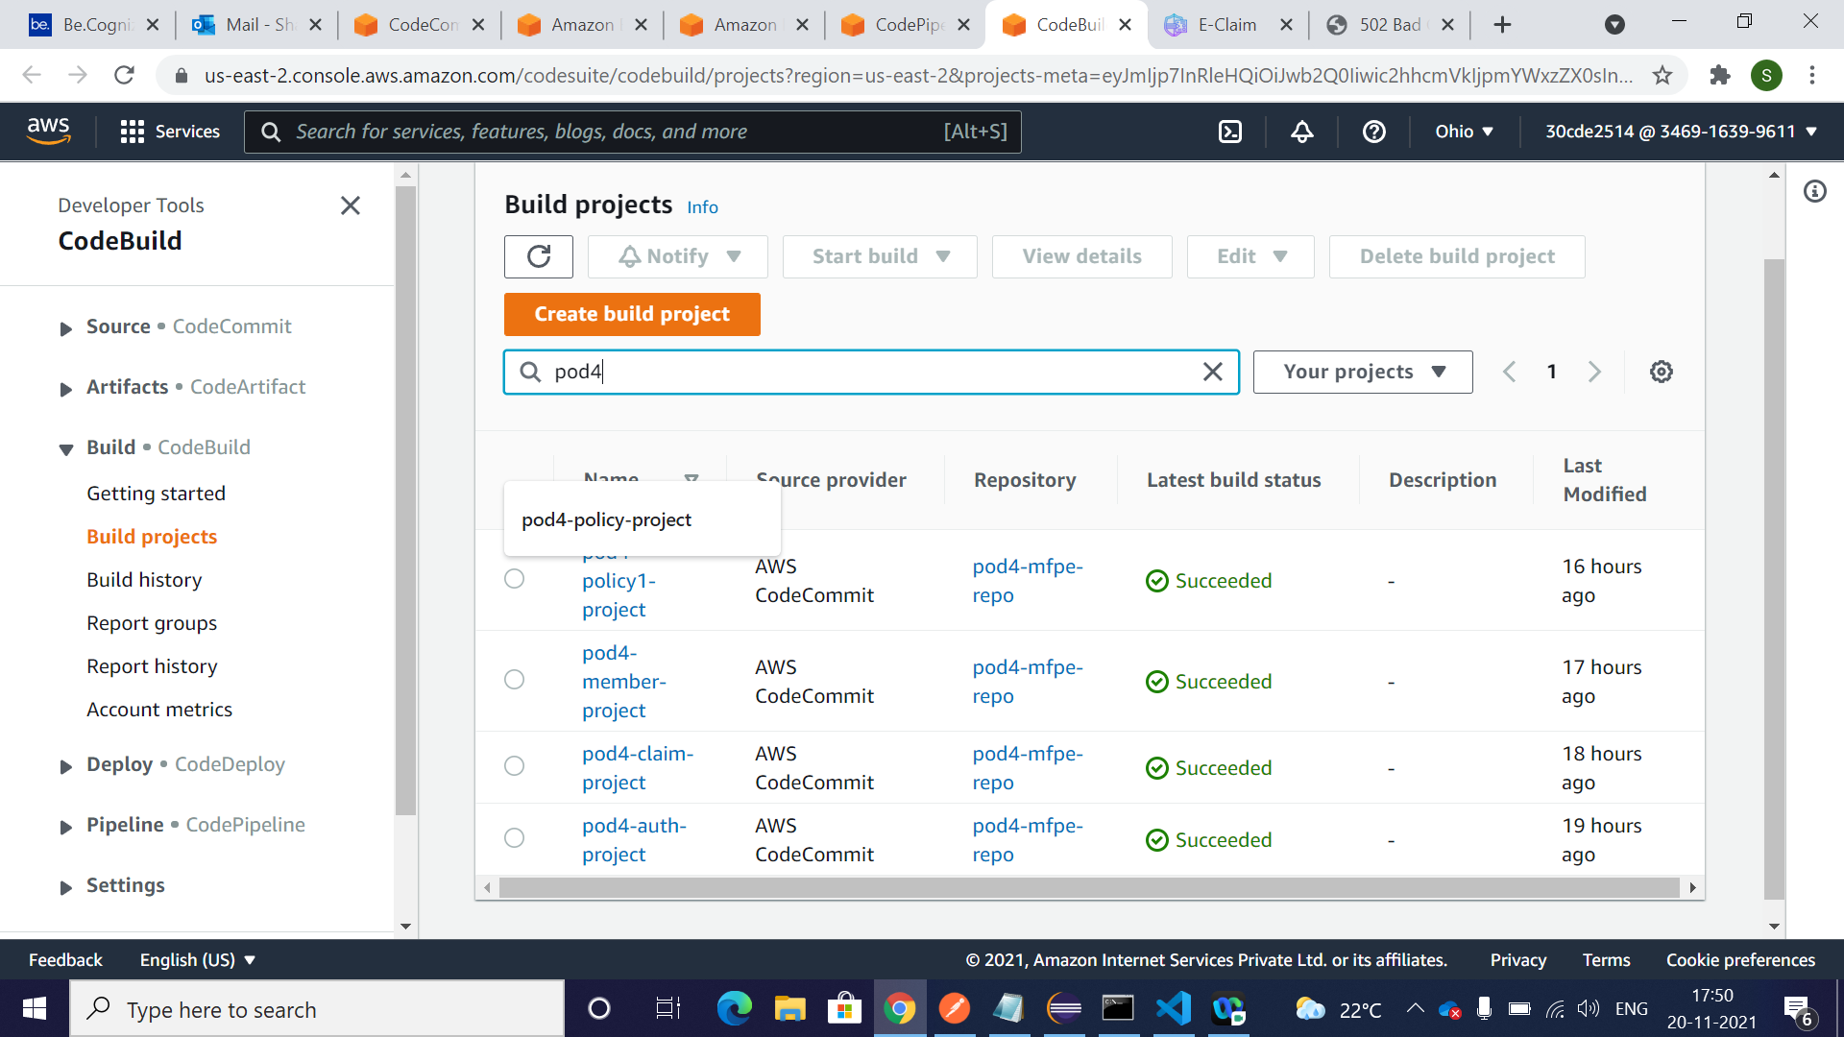
DEPLOYMENT
CLOUD DEPLOYMENT – CODE BUILD

Slide 29
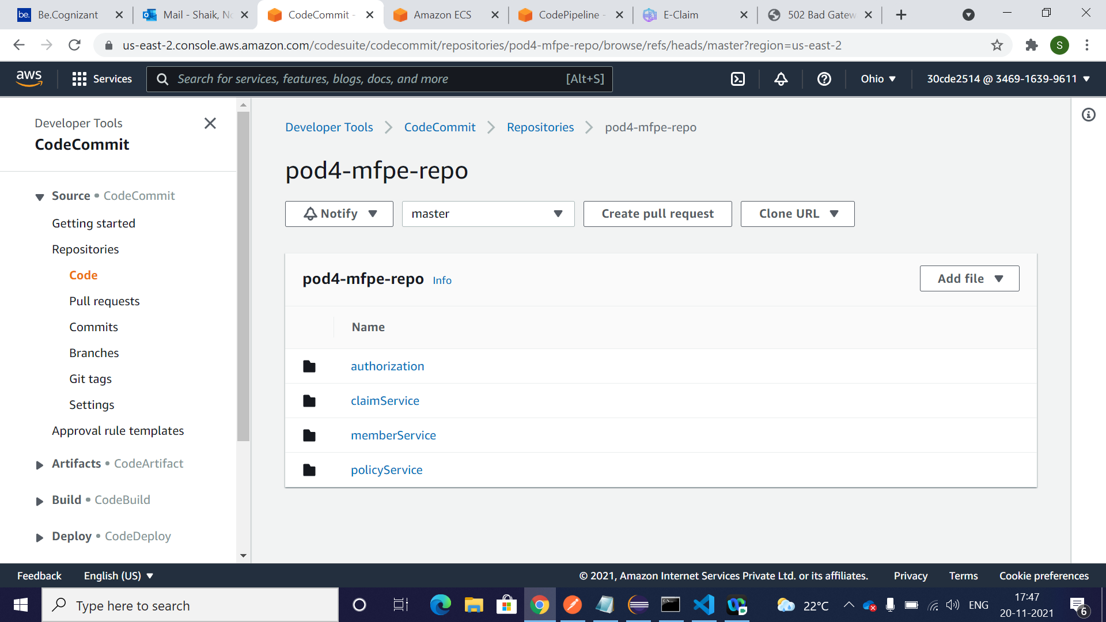
DEPLOYMENT
CLOUD DEPLOYMENT – CODE COMMIT

Slide 30
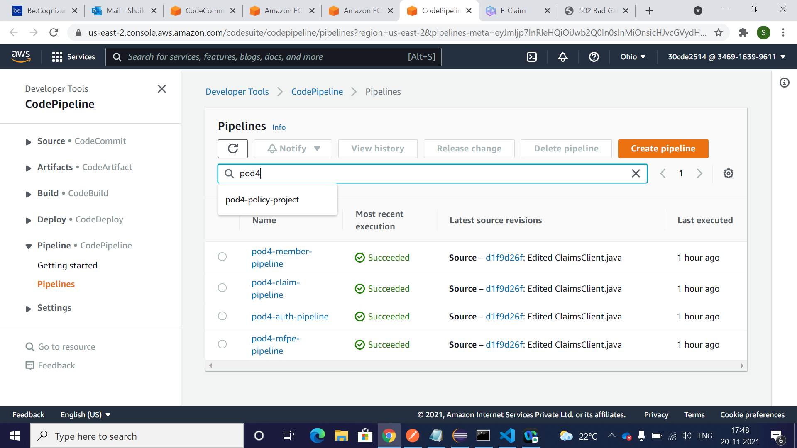
DEPLOYMENT
CLOUD DEPLOYMENT – CODE PIPELINE

Slide 31
Thank You

